Slide 1


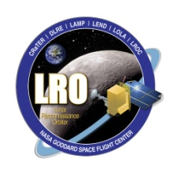

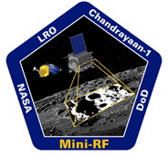

NAC & Mini-RF
Arturo Martinez
Mark Robinson
Mentor
Sam Lawrence
Project Manager

Slide 2
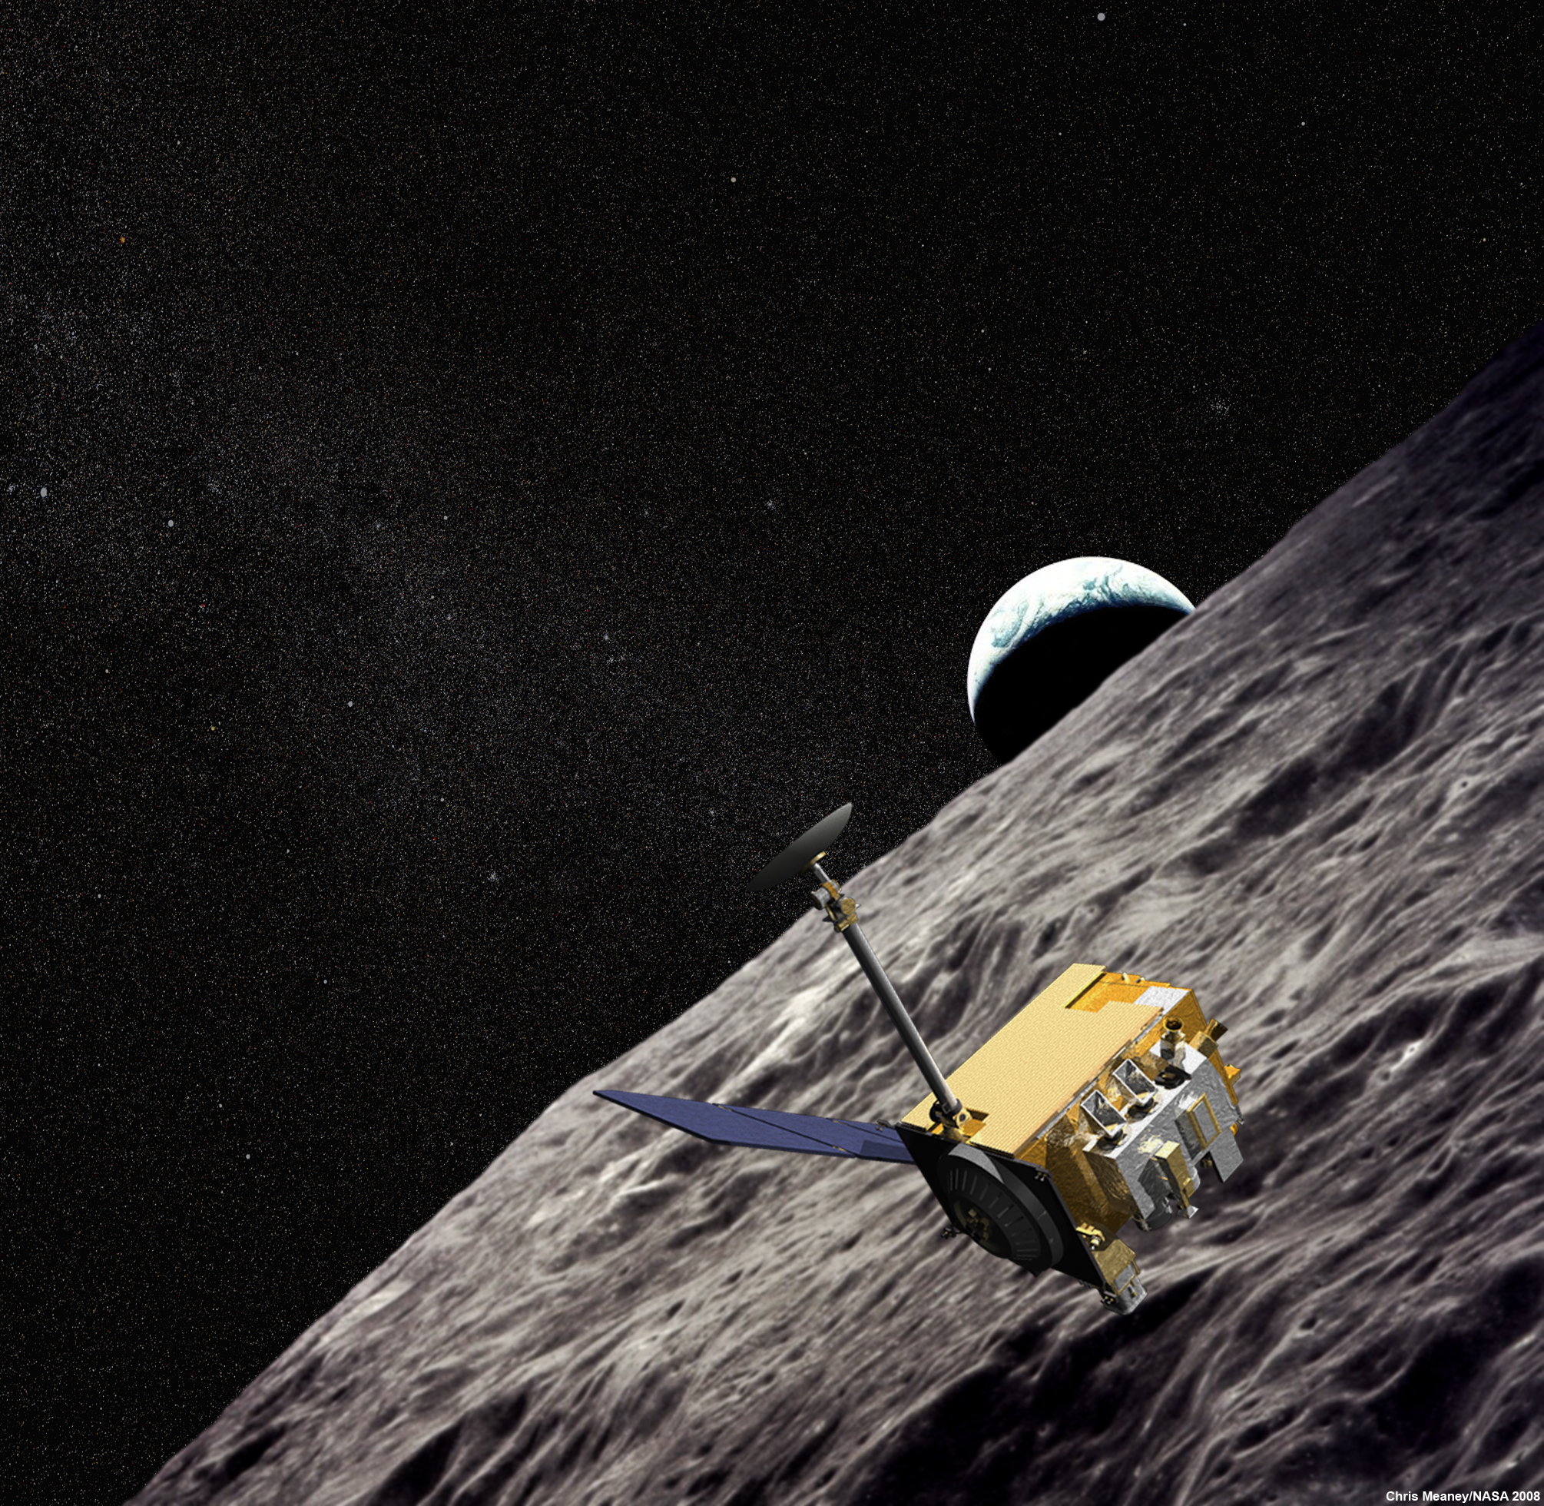
Goal
Determine geology of targeted lunar surface using two active NASA payloads.
Lunar Reconnaissance Orbiter
LRO

Slide 3
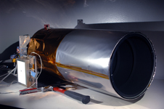
Lunar Reconnaissance Orbiter Camera
LROC
Two Narrow Angle Cameras
NAC
One Wide Angle Camera
WAC
0.5 meter/pixel, BW
7-band UV/VIS color

Slide 4
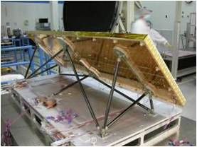
Miniature Radio Frequency
Mini-RF
Sensitive surface roughness
Subsurface roughness
Composition

Slide 5
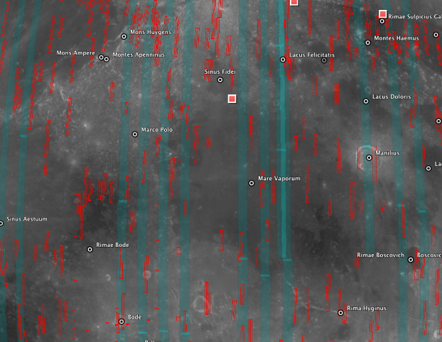
Method
Locate NAC and Mini-RF overlap
Download observations
Convert raw data
Re-project
Manipulate data

Slide 6
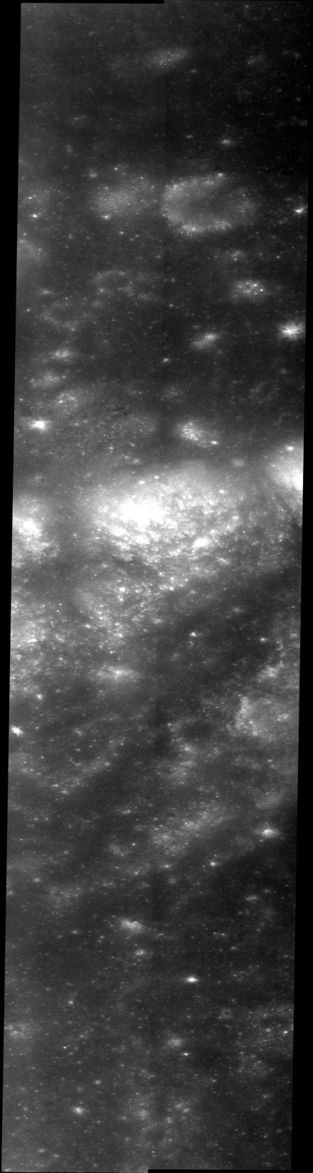
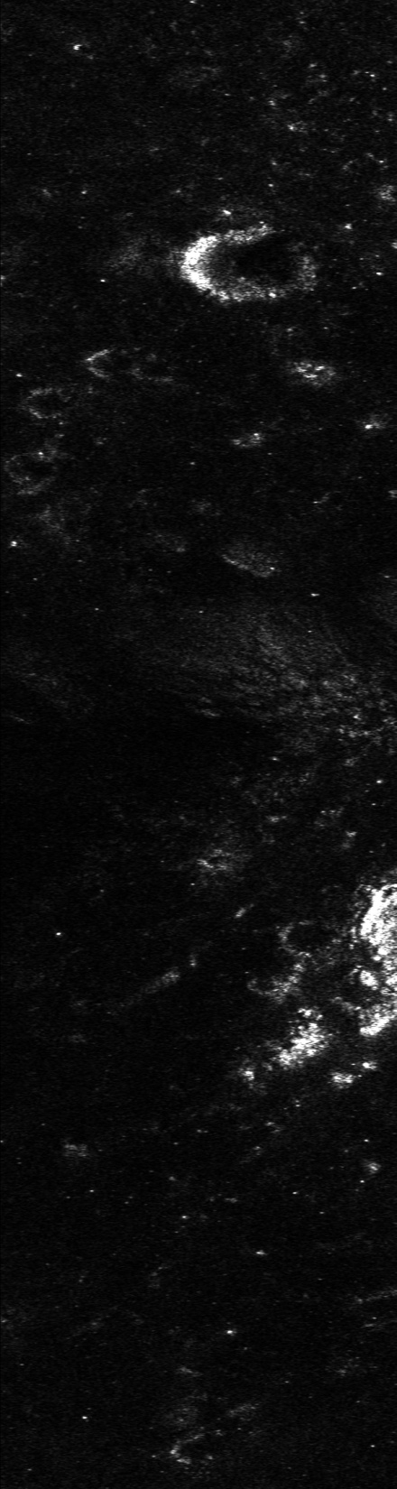
Rimae Maestlin
Fig. 1: LROC NAC image M109494669R
Fig. 2: Mini-RF Radar LSR_CDR_LV2_01790J0sz_V00

Slide 7
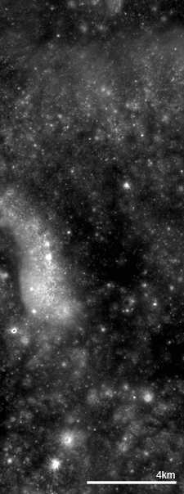
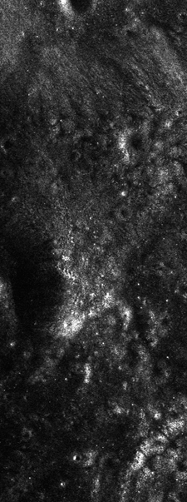
Riccioli
Impact Structure
Fig. 3: LROC NAC image M107358008
Fig. 4: Mini-RF Radar at same location

Slide 8
Challenges
Active missions
Downloading data
Conversion
Experience

Slide 9
Thank You!
Questions?

